Slide 1
Chapter 3 Data Structures and Applications
Fikadu Wayesa

Slide 2
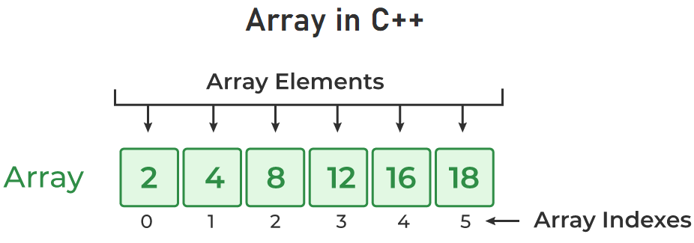
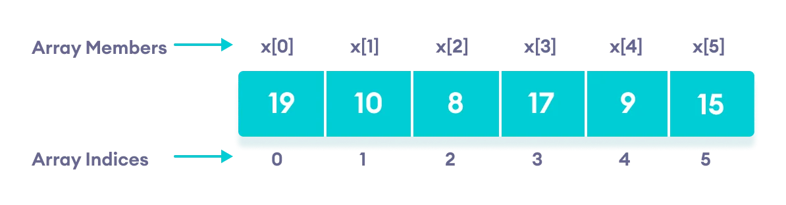
C++ Arrays
In C++, an array is a data structure that is used to store multiple values of similar data types in a contiguous memory location.
For example, if we have to store the marks of 4 or 5 students then we can easily store them by creating 5 different variables but what if we want to store marks of 100 students or say 500 students then it becomes very challenging to create that numbers of variable and manage them.
Now, arrays come into the picture that can do it easily by just creating an array of the required size.
https://www.geeksforgeeks.org/cpp-arrays/
https://www.programiz.com/cpp-programming/arrays

Slide 3
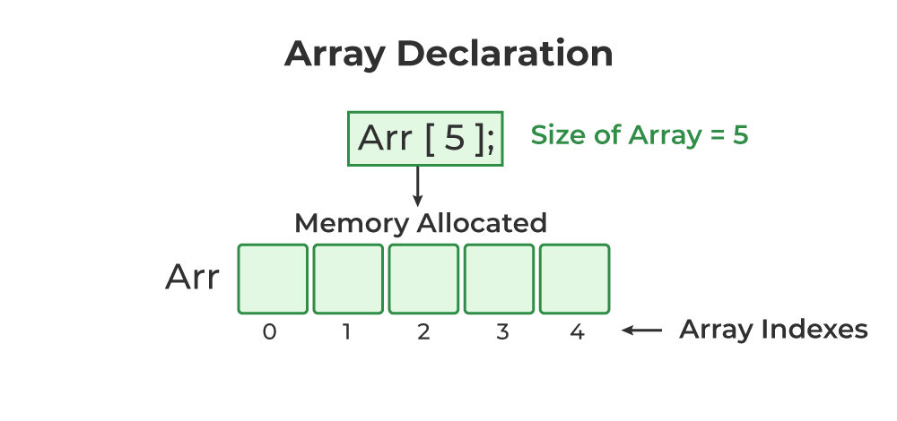
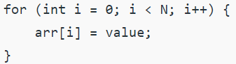
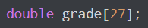
Array Declaration in C++
data_type array_name[Size_of_array]; Example: int arr[5];
Here,
sint: It is the type of data to be stored in the array. We can also use other data types such as char, float, and double.
arr: It is the name of the array.
5: It is the size of the array which means only 5 elements can be stored in the array.
Initialization of Array in C++
1. Initialize Array with Values in C++
int arr[5] = {1, 2, 3, 4, 5};
2. Initialize Array with Values and without Size in C++
Suppose a class has 27 students, and we need to store the grades of all of them. Instead of creating 27 separate variables, we can simply create an array:
int arr[] = {1, 2, 3, 4, 5};
3. Initialize Array after Declaration (Using Loops)

Slide 4
Disadvantages of array
Homogeneity: An array is made up of same data type. That is, in an integer array only integer values can be stored, while in a float array only floating value and character array can have only characters. Thus, no array can have values of two data types.
Fixed size: Arrays are fixed, meaning that it cannot be changed once its size is determined at the time of declaration. This can be a major limitation if the size of the array needs to be flexible as per requirement.
Lack of flexibility: Arrays are static and cannot be dynamically re-sized. Once an array is declared, its size remains constant throughout the program's lifetime. This can lead to wasted memory if the array size is larger than what is needed or limited space if it needs to be bigger.
Wasted memory: When an array is declared, its size must be fixed and allocated at compile time. This means that all elements in the array need to be initialized even if they are not used. For instance, if you declare an array with a size of 10, but only need to use 5 elements at runtime; then 4 elements will remain unused and wasted.
https://www.geeksforgeeks.org/applications-advantages-and-disadvantages-of-array-data-structure/

Slide 5
Structures
We have already dealt with arrays. Arrays are used to store similar type of data. Have you ever thought if there is any way to store dissimilar data?
The answer is yes. We use structures to store different types of data. For example, you are a student. Your name is a string and your phone number and roll_no are integers. So, here name, address and phone number are those different types of data. Here, structure comes in the picture.
We need to store a group of data whether of similar data types or non-similar data types.
In structure, we to introduce new data type (User defined)
A struct is heterogeneous in that it can be composed of data of different types.
In contrast, array is homogeneous since it can contain only data of the same type.

Slide 6
Structure Datatype in C++
Various Built-in Data types allow a programmer to store data elements that are of similar types.
For example, the Integer data type allows us to store only non-decimal numerical values, the Character data type allows us to store single characters in the variable, etc.
But what if we want to store a variety of data that are of different types?
For this purpose, programming languages allow the user to create a User-defined Data type.
These User-Defined data types store values of similar or different types.
One such User-defined Data type is the Structure Data type.
A Structure is a user-defined data type that is used to store similar, different data types or a combination of both under a single variable in C/C++ .
Unlike Array, a Structure is used to store a collection of different types of data elements under a single variable name.

Slide 7
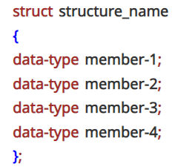
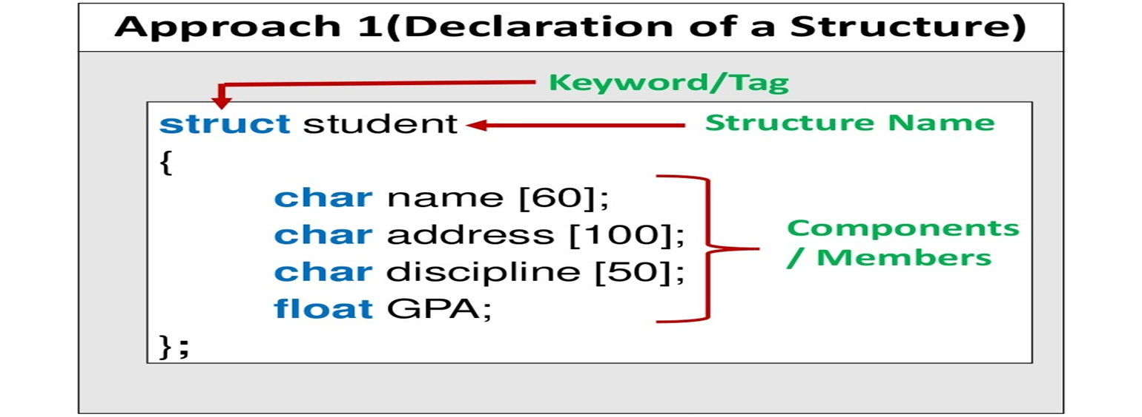
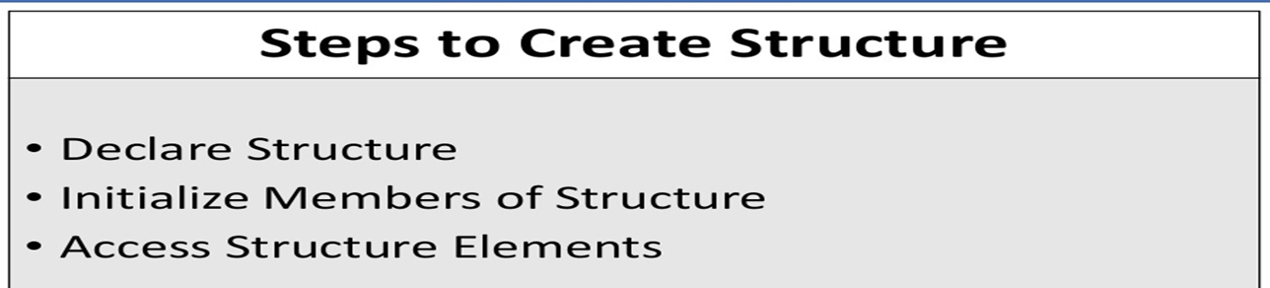
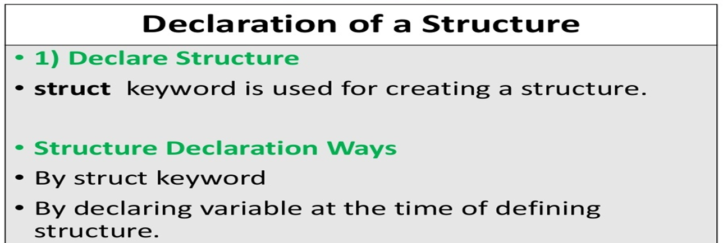
Defining a Structure
In our case, let's name the structure as student. The members of the structure in our case are name, roll_no and phone_number.
struct student
{
int roll_no;
string name;
int phone_number;
};
Components of Structures
Data Member: These members are variables of different data types in C++.
Member Functions: These members are normal C++ functions.

Slide 8
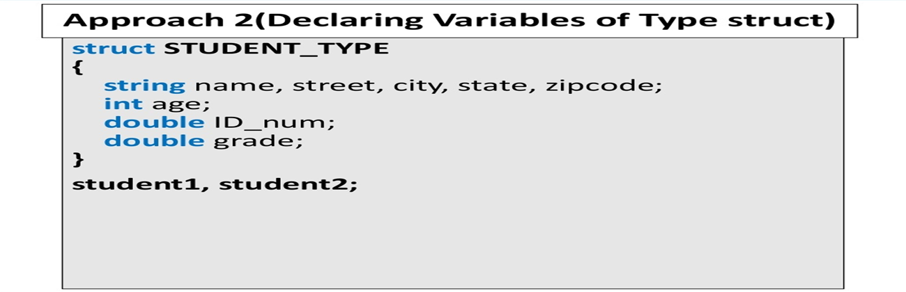
Declaration of Structure Variable
Just as we declare variables of type int, char etc, we can declare variables of a structure as well.
Suppose we want to store the roll no, name and phone number of three students.
For this, we will define a structure named student (as declared above) and then declare three variables, say p1, p2 and p3 (which will represent the three students respectively) of type 'student’.
This declaration will be done in the main function.
struct student
{
int roll_no;
string name;
int phone_number;
};
int main()
{
struct student p1, p2, p3;
return 0;
}
We can also declare structure variables at the time of defining the structure as follows.
struct student
{
int roll_no;
string name;
int phone_number;
}p1, p2, p3;

Slide 9
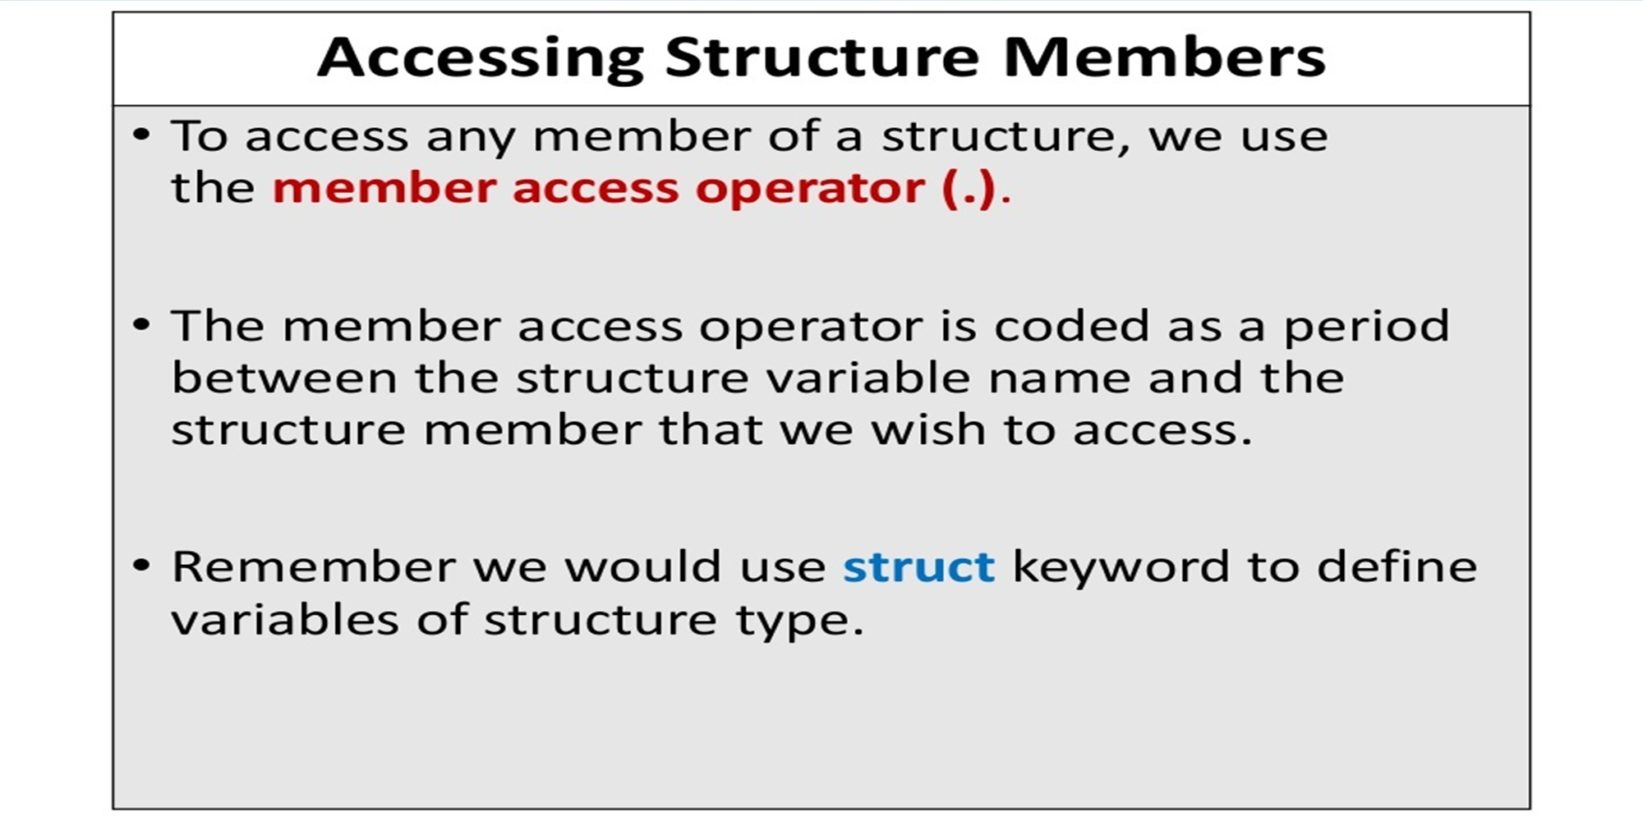
Accessing Structure Members
Now, let's see how to enter the details of each student i.e. roll_no, name and phone number.
Suppose we want to assign a roll number to the first student.
For that, we need to access the roll number of the first student.
This means that we use dot (.) to use variables in a structure. p1.roll_no can be understood as roll_no of p1.
The dot operator is one way to initialize individual members of a structure variable in the body of your program.

Slide 10
Exercise
: Write a C++ program that creates and stores a student record consists of ID, Name, department, sex, age and CGPA using structures. (The data should be entered from user)

Slide 11
Array of Structures
We can also make an array of structures.
In the first example in structures, we stored the data of 3 students.
Now suppose we need to store the data of 100 such children.
Declaring 100 separate variables of the structure is definitely not a good option.
For that, we need to create an array of structures.
Exercise: Create structure named stud having 5 elements of structure student using array.
Write a C++ Program For Employee Details Using Structure (Use array)
empID (int)
name (char with size 50)
Age (int)
salary (int)
department[50] (char with size 50)

Slide 12
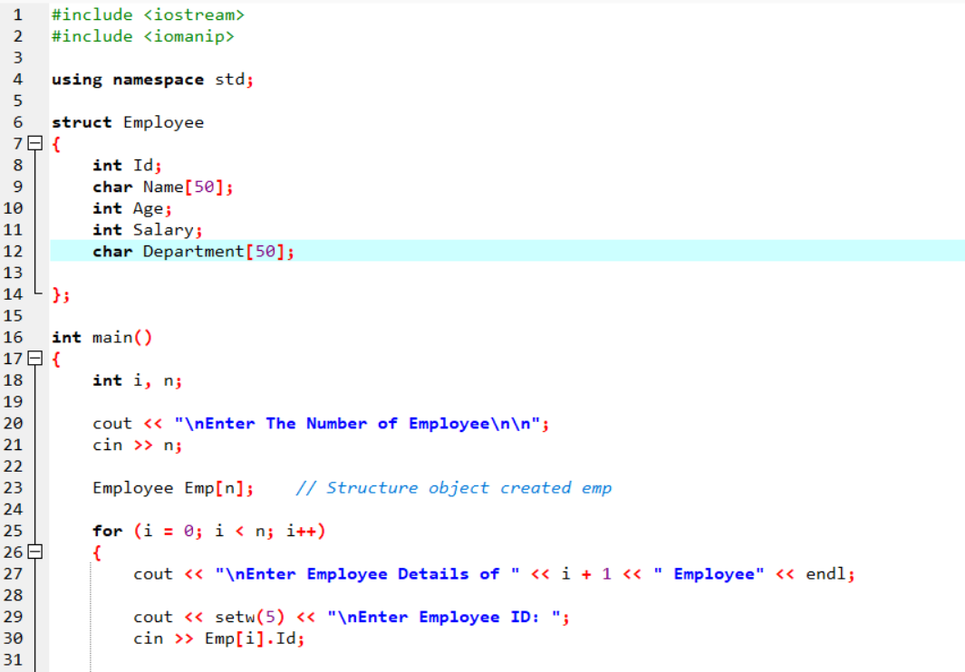
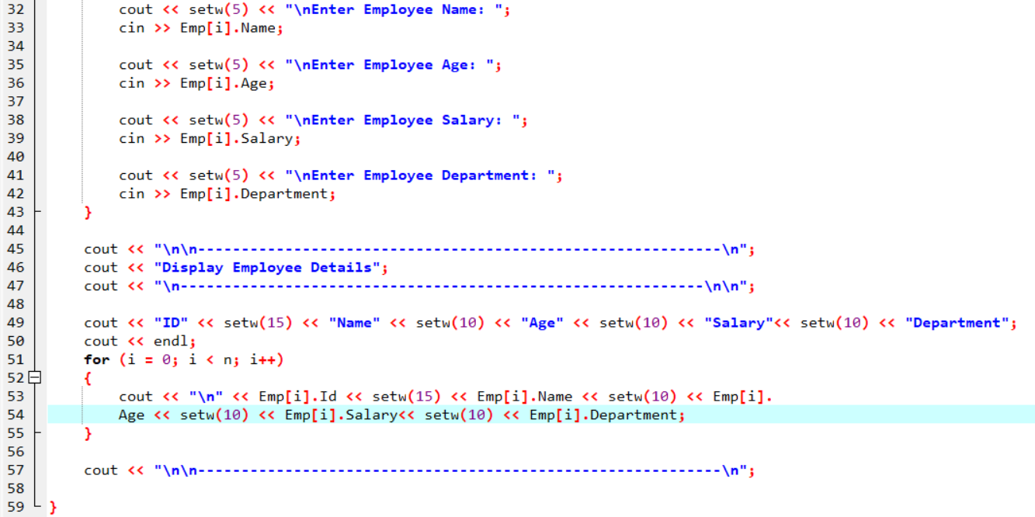
Solution

Slide 13
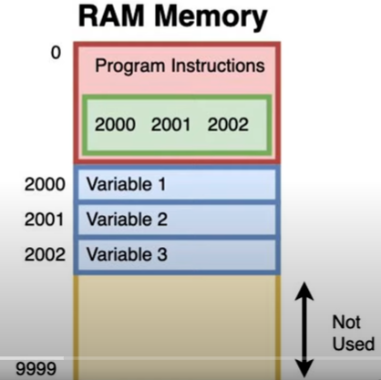
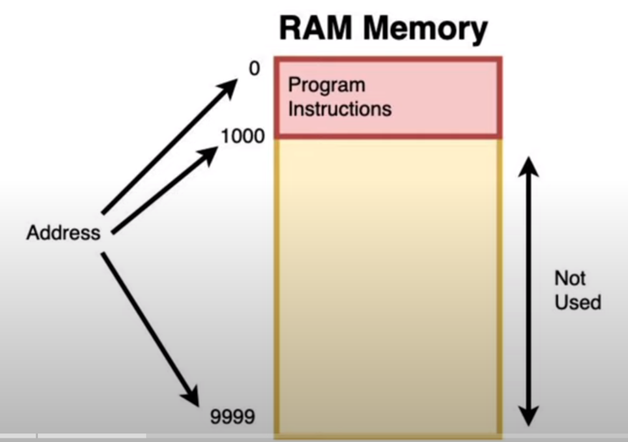
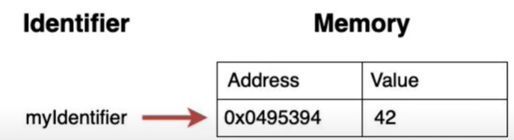
Pointers Data Structures
Programs and data (i.e variables) are both stored in a computer's memory while executing.
When your program create variables, they are stored in memory at memory address
Memory addresses are a positive integer that uniquely identifies a position in a memory.

Slide 14
Pointers Data Structures
Pointers are a variables that stores a memory address
A pointer is a type of variable that holds the memory address of another variable.
When you create a pointer, you must specify the type of data that it will point to.
This could be a primitive data type, such as an integer or a character, or a complex data type, such as an array or a structure.
To access the value stored at the memory address held by a pointer, you use the * operator.
This is known as dereferencing the pointer.
When you dereference a pointer, you access the data stored at the memory address held by the pointer.
Pointers are used to create dynamic data structures, such as linked lists, that can grow and shrink as needed.
They can also be used to pass data between functions, making your programs more flexible and reusable.
Pointers allow you to allocate and free memory dynamically, so that you can create large data structures that can grow and shrink as needed.
This makes it easy to create flexible, efficient programs that can handle changing requirements.

Slide 15
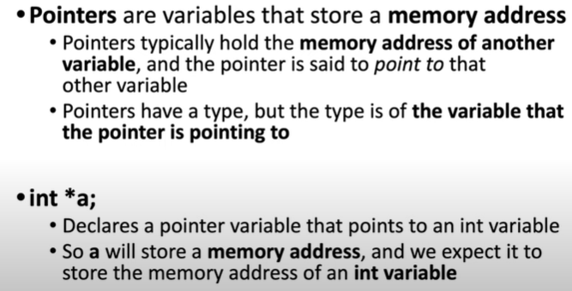
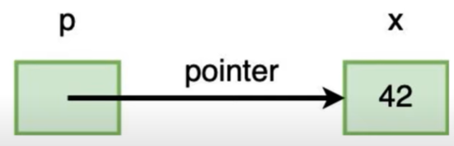
Pointers
Pointers point to a variable

Slide 16
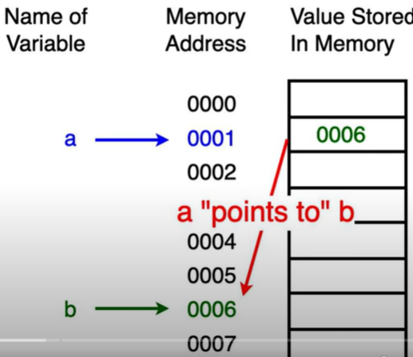
Pointers
Pointer points to the variable by storing its memory address.
Int b=42;
Int *a;//declare a variable a there is going to be pointer, int means it points to int values.
How do we get a variable’s memory address?
& variable – This operator returns the memory address of a variable.
To have a variable points to b variable we have to use operator & (ampersand). That means a stores memory address of b.
a=&b;// or int *a=&b
What will be the following output?
Cout<<b; //42
Cout<<&b; //address of b
Cout<<a;//address of b

Slide 17
Pointers
We can actually use variable a to modify the value of b by dereference operator (& and *)
Int *p=&a// This will assign the variable pointer p the memory address of.
*a=50;
Cout<<b;//50
Cout<<&b; // address of b
Cout<<a; // address of b

Slide 18
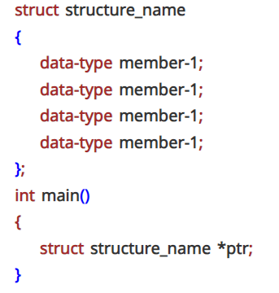
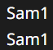
Pointers to Structure
A pointer variable can be created not only for native types like (int, float, double etc.) but they can also be created for user defined types like structure.
We can define a pointer to a structure in the same way as any pointer to any type.
#include <iostream>
#include <string>
using namespace std;
struct student
{
string name;
int roll_no;
};
int main(){
student stud = {"Sam",1};
student *ptr;
ptr = &stud
cout << stud.name << stud.roll_no << endl;
cout << ptr->name << ptr->roll_no << endl;
return 0;
}
To access the member variable using a pointer, we use pointer followed by arrow operator(->) and then the name of the member variable.

Slide 19
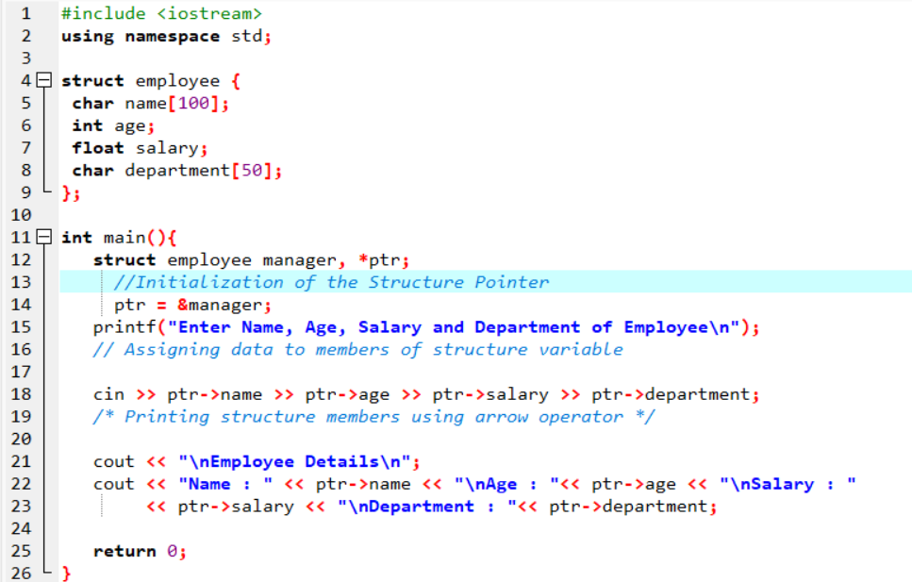
Pointers to Structure
struct empl *ptr; - We declared 'ptr' as a pointer to the structure student.
ptr = &stud - We made our pointer ptr to point to the structure variable stud.
Thus, 'ptr' now stores the address of the structure variable 'stud’.
ptr = &structure_variable;

Slide 20
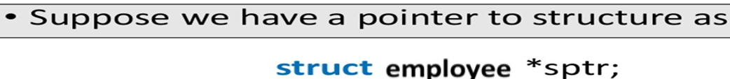
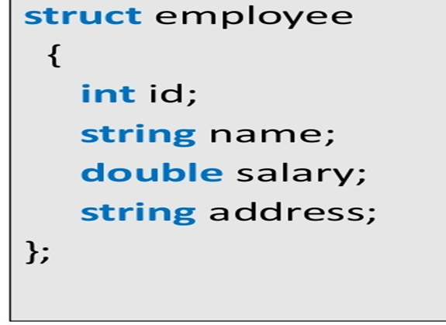
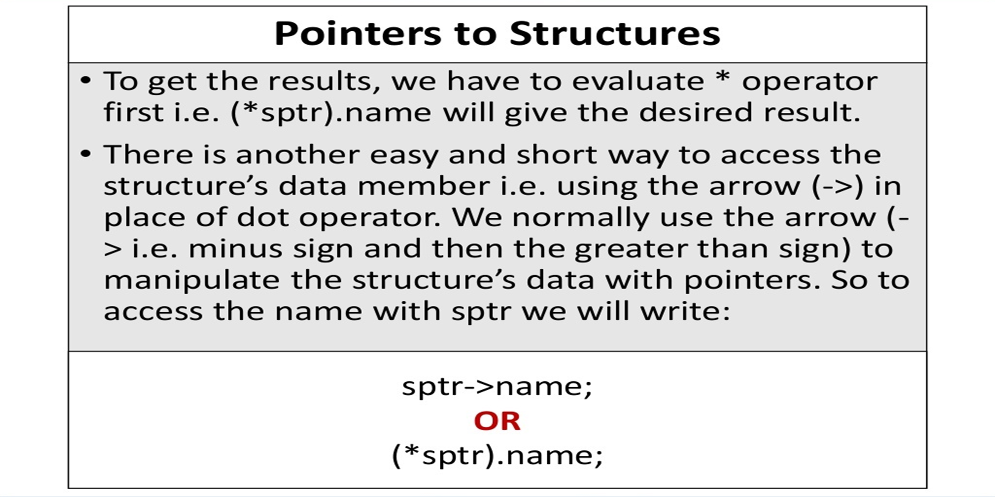
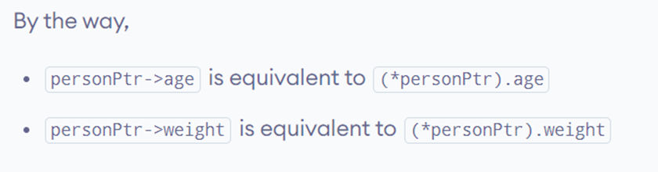
Pointers to Structure

Slide 21
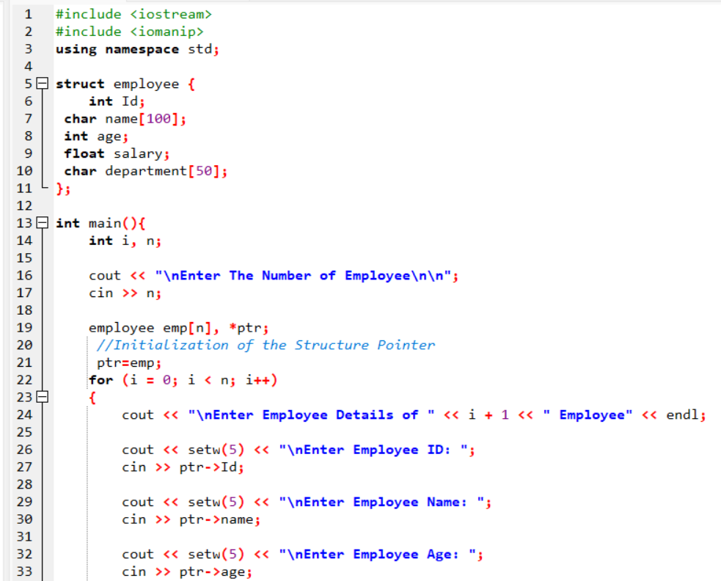
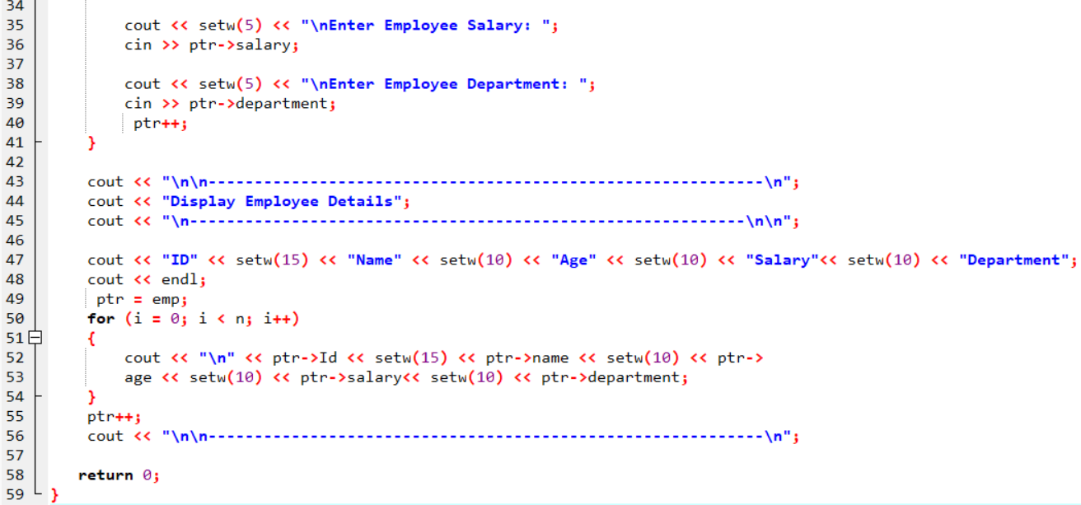
Accessing each element of the structure array variable via pointer

Slide 22
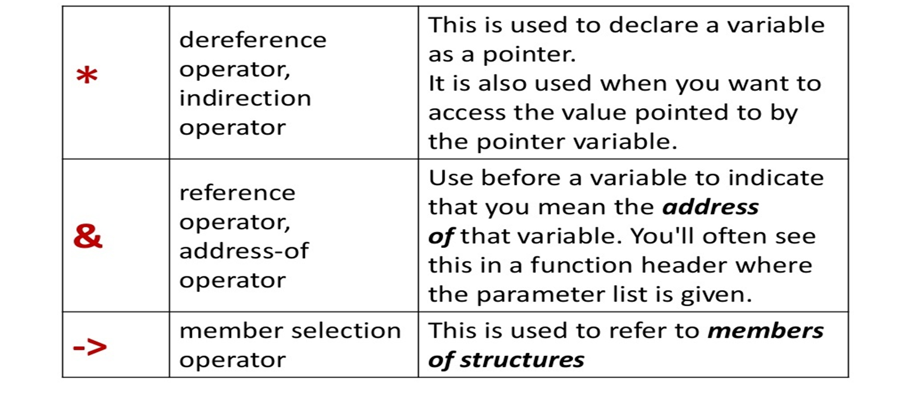
Pointer Operators (Summary)

Slide 23
Limitation of a C++ structure
The struct data type cannot be treated like built-in data types.
Operators like + -, and others cannot be used on structure variables.
Structures don't support data hiding.
The members of a structure can be accessed by any function regardless of its scope.
Static members cannot be declared inside the structure body.
Constructors cannot be created inside a structure.

Slide 24
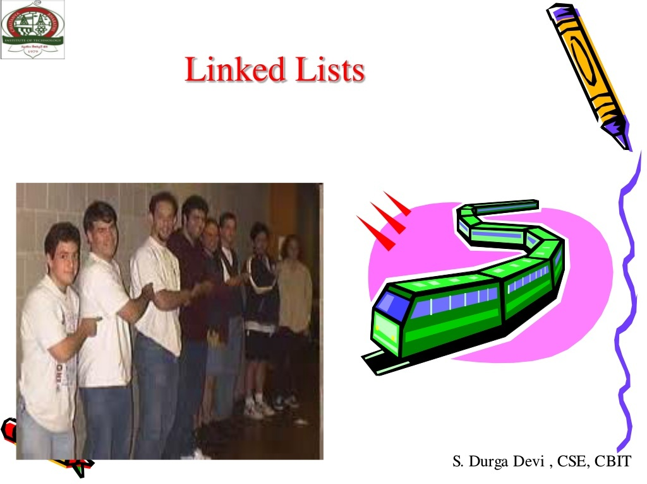

Slide 25
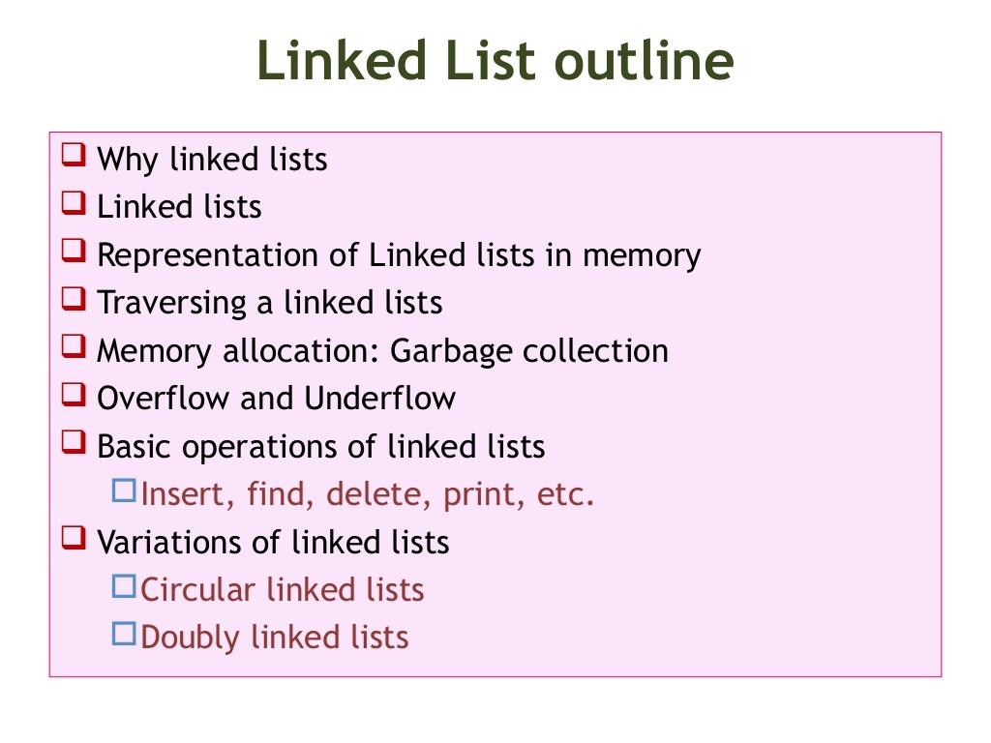

Slide 26
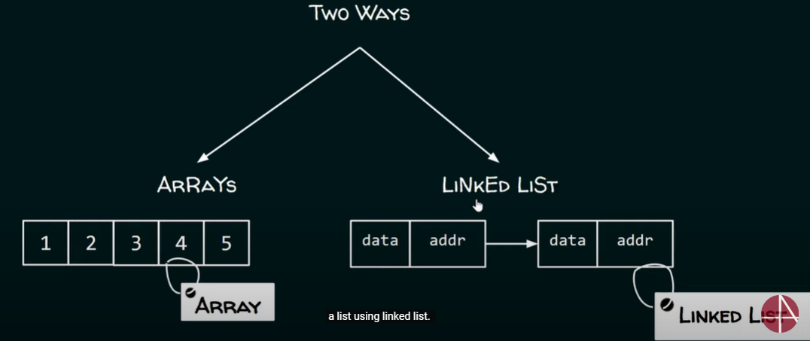
Introduction
Problem- Arrange the name of students according to the first letter of their names
Lets say our target is to arrange the name of students according to the first letter of their names.
Michael, Abel, Tola, Chala, Robel, Bekele, Seble
Abel | Bekele | Chala | Michael | Robel | Seble | Tola
Question? How to maintain this?
We can use two ways
Arrays have some limitations and disadvantages
We will see how Linked List overcome the limitations of arrays in the subsequent lectures

Slide 27
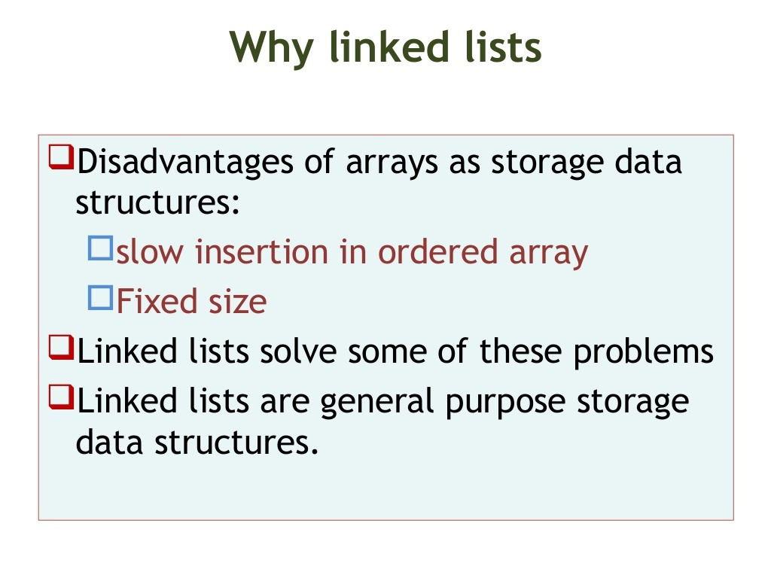

Slide 28
Why linked list data structure needed?
Dynamic Data structure: The size of memory can be allocated or de-allocated at run time based on the operation insertion or deletion.
Ease of Insertion/Deletion: The insertion and deletion of elements are simpler than arrays since no elements need to be shifted after insertion and deletion, Just the address needed to be updated.
Efficient Memory Utilization: As we know Linked List is a dynamic data structure the size increases or decreases as per the requirement so this avoids the wastage of memory.
Implementation: Various advanced data structures can be implemented using a linked list like a stack, queue, graph, hash maps, etc.
Dynamic Size: Linked lists can grow or shrink dynamically, as memory allocation is done at runtime.
Insertion and Deletion: Adding or removing elements from a linked list is efficient, especially for large lists.
Flexibility: Linked lists can be easily reorganized and modified without requiring a contiguous block of memory.
Disadvantages of Linked Lists
Random Access: Unlike arrays, linked lists do not allow direct access to elements by index. Traversal is required to reach a specific node.
Extra Memory: Linked lists require additional memory for storing the pointers, compared to arrays

Slide 29
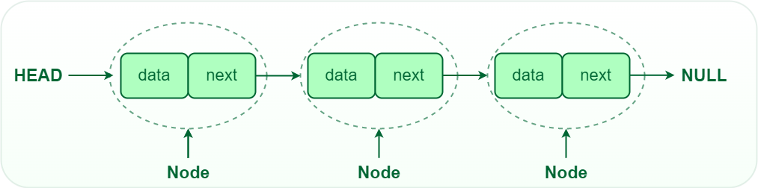
Single Linked List
Linked List is a linear data structure, in which elements are not stored at a contiguous location, rather they are linked using pointers.
Made up of nodes connected together by pointers.
Linked List forms a series of connected nodes, where each node stores the data and the address of the next node.
A linked list is a linear data structure that includes a series of connected nodes. Here, each node stores the data and the address of the next node.

Slide 30
Linked List
A linked list is the most sought-after data structure when it comes to handling dynamic data elements.
A linked list consists of a data element known as a node.
And each node consists of two fields: one field has data, and in the second field, the node has an address that keeps a reference to the next node.
A linked list is a linear data structure that stores a collection of data elements dynamically.
Nodes represent those data elements, and links or pointers connect each node.
Each node consists of two fields, the information stored in a linked list and a pointer that stores the address of its next node.
The last node contains null in its second field because it will point to no node.
A linked list can grow and shrink its size, as per the requirement.
It does not waste memory space.

Slide 31
Linked List
Node Structure: A node in a linked list typically consists of two components: Data: It holds the actual value or data associated with the node. Next Pointer: It stores the memory address (reference) of the next node in the sequence. Head and Tail: The linked list is accessed through the head node, which points to the first node in the list. The last node in the list points to NULL or nullptr, indicating the end of the list. This node is known as the tail node.
https://www.geeksforgeeks.org/what-is-linked-list/
https://www.programiz.com/dsa/linked-list
Successive elements are connected by pointers.
First element points to Head.
Last element points to NULL.
It can grow or shrink in size during execution of a program.
It can be made just as long as required.
It does not waste memory space.

Slide 32
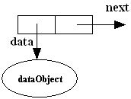
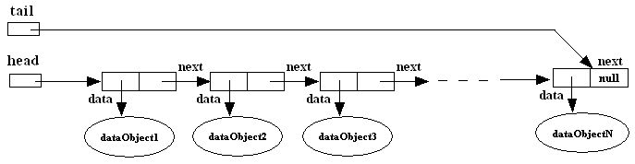
What is a Singly-linked list?
A singly linked list is a dynamic data structure consisting of a sequence of nodes, forming a linear ordering.
Each node stores:
Element (data object)
Reference (i.e., address) to the next node
Node:
Singly-linked list:
Notes:
32

Slide 33
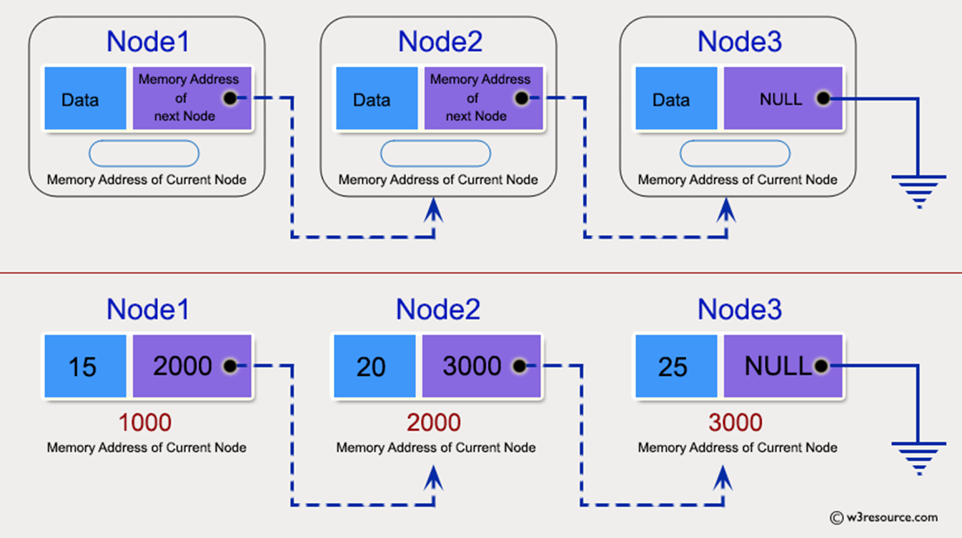

Slide 34
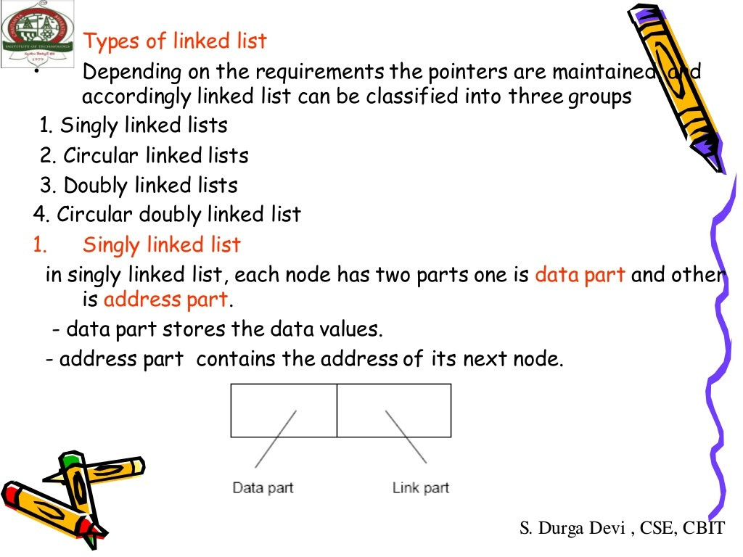
Types of Linked List
Single Linked List- Navigation is forward only.
Doubly Linked List- Forward and backward navigation
Circular Linked List- Last element is linked to the first element

Slide 35
Basic Linked List Operations
List Traversal
Searching a node
Insert a node
Delete a node

Slide 36
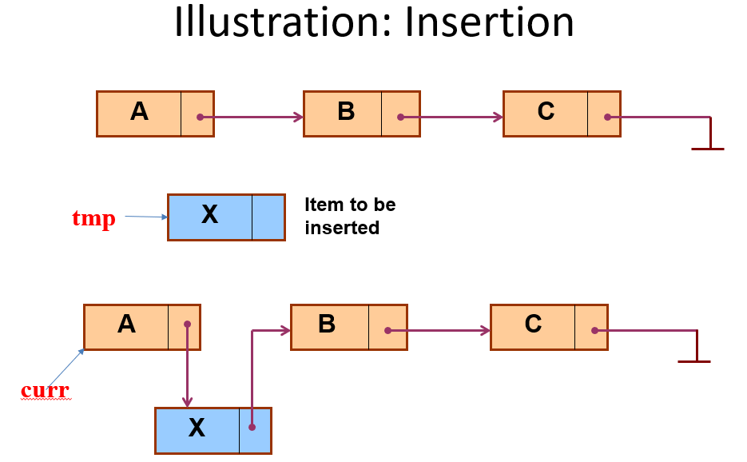
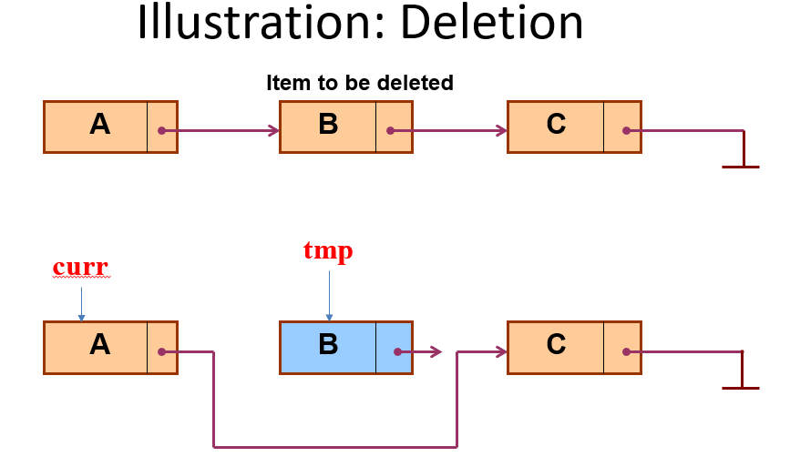
LL Operations
Insert an element- add element
Beginning (front)
Middle
Last (end)
Delete an element- delete an element
Beginning
Middle
Last
Display an element- display the complete list
Search an element- searches element using key

Slide 37

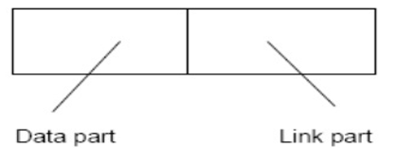
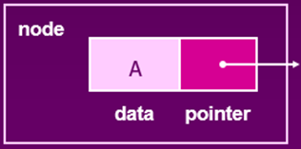
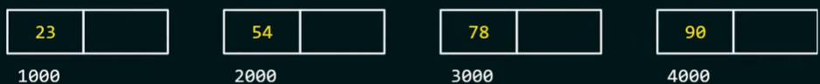
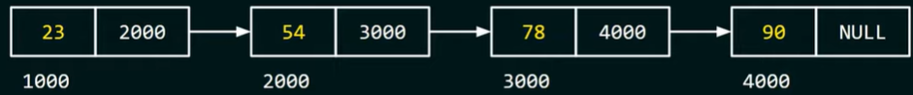
Single Linked List
A single linked list is a list made up of nodes that consists of two parts
Data – This part contains the actual data
Link – Contains the address of the next node of the list
Suppose, we want to store a list of numbers: 23, 54, 78, 90
For this purpose, we want to create four different nodes.

Slide 38
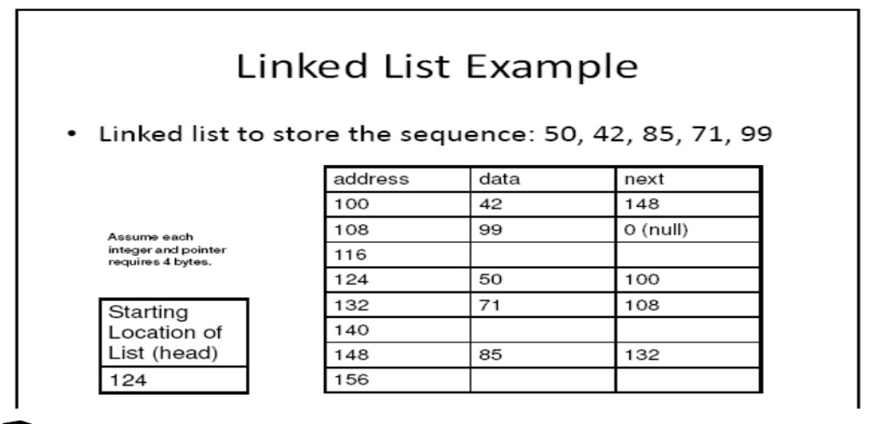
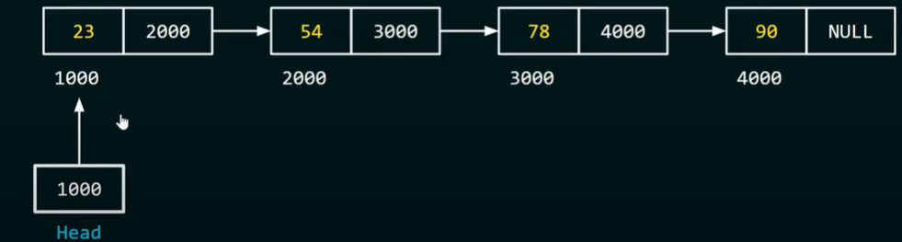
How to access the first Node?
In order to access the first node of the linked list, we need a pointer.
Let we name the pointer as head (Conventional)
Nodes are scattered in the memory location but they are connected with each other.
So, Linked list is the linked representation of list.
Where as Array is a sequential representation of list.

Slide 39
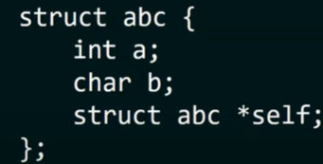
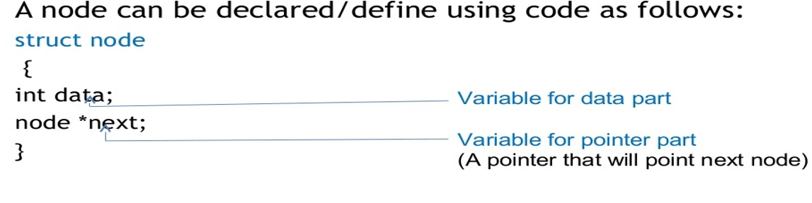
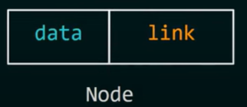
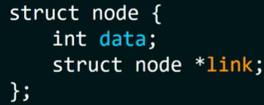
Representation of Linked List
Self Referential Structure is a structure which contains a pointer to structure of the same type.
We have structure called abc, which contains a pointer to the structure abc.
So it is said to be self referential structure.
We will use self referential structure for creating a node of the Single Linked List.
Node is the combination of two types,
Data part could be any data type , we use int type for simplicity purpose here.

Slide 40

We could have multiple data members, but must be single one pointer (link)

Slide 41


Storing data in a node

Slide 42


Slide 43


Slide 44


Slide 45


Slide 46



Linked List Implementation in C++
Struct node{
Int data;
node*next;
};
To traverse the list we need to point the first node as head.
node*head=NULL;//shows list is empty
Allocate memory for new node
struct node *temp= malloc(sizeof(struct node));// if you are using c language
Node*temp=new node();// if it is c++
2. Store data
(*temp).data=2;
(*temp).next=NULL; or
head=temp;
head
NULL
If you are using c++ language
temp->data=2;
temp->next=NULL;
head=temp;

Slide 47





To create the second node
Temp=new node();
Temp->data=4;
Temp->next=NULL;
Rather than doing this:
node*temp2=new node();
while(temp2!=NULL){
temp2=temp2->next;
}
temp2->next=temp;
Update the link part of the first node to point to the second node with the following line of code.
traversal

Slide 48




Inserting a node at the beginning :SLL

Slide 49


Insert node at end
Traversing (Printing) a Linked List

Slide 50



Deletion Operation
Deleting First Element
Deleting Last Element

Slide 51



Deleting Last Node

Slide 52


Slide 53

Representation of Linked List
Let's see how each node of the linked list is represented. Each node consists:
A data item
An address of another node
We wrap both the data item and the next node reference in a struct as:

Slide 54

Exercises
Write a c++ program that counts the number of nodes in a singly linked List.
Write a c++ program that inserts an element at nth position in a singly linked List.
Write a c++ program that delete an element from nth position in a singly linked List.
Write a c++ program that reverse a list in linked list.

